Slide 1
CIE Review of Bering Sea P-cod
Additional information on Bering Sea p-cod fisheries from the Freezer-Longline Coalition (FLC = Catcher-processor hook-and-line vessels)

Slide 2
Pacific Cod Fisheries of the Bering Sea: Ten federal sectors with four gear types (+ statewater GHL fishery)
Catcher-processor hook-and-line (CP H&L): Freezer-longliners: highest dependency on BS p-cod.
Pot Catcher-processors (CP pot): CP pot vessels that fish for crab and p-cod.
Amendment 80 Catcher-processors (A.80): CP trawl vessels (non-pollock); p-cod taken incidentally in multiple flatfish fisheries; only sector with a hard p-cod cap; uses cod excluders
Catcher vessel fixed gear <60’ (CV <60’): Wide-body vessels less than 60’ that mostly pot gear
Pot Catcher vessels >60’: CV pot vessels over 60’ that fish for crab and p-cod
Catcher vessel trawl (CV trawl): Trawl vessels that fish for pollock and/or p-cod;. Short directed p-cod fishery in early A season; then incidental catch in other fisheries (pollock, YFS)
AFA Catcher-processor trawl (AFA CP trawl): Large pollock CPs; mostly incidental harvest of p-cod
Catcher vessel hook-and-line >60’ (CV H&L >60’): Small sector with little effort or dependency
Jig gear: Small vessel access opportunity; uncaught allocation rolls to CV fixed gear <60’ inseason
Community Development Quota (CDQ): Western Alaska Native communities own 10.7% of BS p-cod; harvested in multiple sectors and gear types in both directed and incidental fisheries
Statewater: Guideline Harvest Level = 10% of BS ABC; harvested by pot gear <60 in open access derby fishery with no limit on permits.

Slide 3
BSAI p-cod: Dependency by federal sector: Average proportion of sector’s total gross revenues from BSAI P-cod (2005 -2017). However p-cod is an important part of each sector and there can be higher dependency for p-cod for specific vessels within a sector (from the A.85 program review, NPFMC June 2019)
Sector Dependency Number of Licenses
CP H&L: 67% 36
Pot CP: 41% 8
A. 80: 21% 26
CV fixed gear <60 16% 129
Pot CV >60 12% 49
CV trawl 8% 114
Jig 2% (not limited)
AFA CP 1% 27
CV H&L >60 0% 8

Slide 4
CP H&L: Freezer Longliners
36 licenses with 18-22 active vessels
Catcher-processors: High quality longline caught p-cod that is individually bled, processed, and frozen-at-sea (FAS).
Vessels are 100% observed; equipped with flow scales and video cameras.
Vessels use auto-bait systems (predominately Mustad) with squid as bait (with some mix of saury and herring, particularly when squid price is high).
Vessels generally set gear at night (pre-dawn) and then haul during the daylight hours. Fishing occurs in 20 to 60 fathoms.
Fishing grounds span the entire BS shelf break (and some shelf areas) from “cod alley” (near the Alaska Peninsula) to Pribilof Canyon area to Zhemchug Canyon to Pervenets Canyon to the Northern Bering Sea).

Slide 5
Recruitment in the 2020 BS p-cod fisheries (i.e. no BTS survey in 2020)
The 2014-2017 age classes were below average, the 2013 age class was very large (more than double the long term average, p. 123, Table 2.37 of the SAFE).
In the 2019 assessment, the 2018 year class was large in both the EBS and NBS surveys.
In the current 2020 SAFE, each model and ensemble has the 2018 age class as well above average. In the 2020 fisheries, the 2018 year class is also evident in multiple p-cod fisheries.

Slide 6
November 2020 SAFE:
2020 SAFE: “The 2019 size composition shows that the 2018 year class may break that string. Figure 2.8b shows the size compositions from the 2010, 2017, and 2019 NBS surveys. As in the 2019 EBS survey, the 2019 NBS survey indicates that the 2018 year class may be large.” (p.12)
2020 SAFE: “Moreover, numerical abundance took a sharp upturn during 2019 in both the EBS and NBS, due apparently to a strong 2018 year class…….Every model ranked the strength of the 2018 cohort as being between 39-62% above average.” (p. 34)
2020 SAFE: Abundance: “The 2019 EBS estimate was up 95% from 2018 and up 46% from 2017, the 2019 NBS estimate was down 13% from 2018 but up 58% from 2017, and the 2019 EBS+NBS estimate was up 44% from 2018 and up 49% from 2017.” P. 12.

Slide 7
CP H&L fisheries: Product size information from one CP H&L company with multiple vessels fishing for BS p-cod. Generally, the proportion of small fish was higher in 2018, decreased in 2019, and then increased in the 2020 “A” season.

Slide 8
Product size information from two A.80 companies from their vessels that fish almost exclusively in the Bering Sea flatfish fisheries year round. The proportion of A. 80 H&G cod finished product <1.0 kg in 2020 (as of July) is +93% higher in 2020 for Company 1 (three vessels) and +32% higher in 2020 for Company 2 (5 vessels) when compared to 2019.

Slide 9
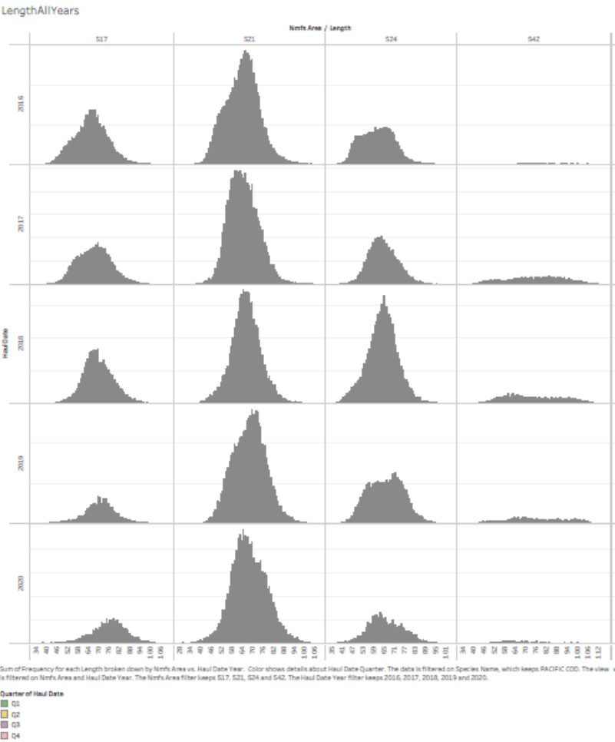
CP H&L BS p-cod fishery: Length compositions, 2016-2020, by area (517 = SBS; 521 = Central BS; 524 = NBS; 542 = CAI) [From SeaState]. Length compositions are consistent over multiple years. There is a shift to smaller fish in 521 and 524 (center columns) in 2020 (bottom row) compared to 2019 and 2018.

Slide 10
CPUE 2020 (derived from the November 2020 SAFE): The all gear CPUE index increased +29% in 2020 and the longline CPUE index increased +14% in 2020. In comparing the all gear CPUE index to the longline CPUE index, it is apparent that the increase in CPUE is from all gear groups (and proportionately higher in gear groups other than longline gear).

Slide 11
BSAI CP H&L p-cod fishery “footprint”, 2008-2018 (From SeaState)
The CP H&L fishery footprint is the most widely distributed p-cod fishery in the Bering Sea. The fishery is primarily on the BS shelf break and shelf in waters 20 to 60 fathoms. The nature of the longline fishery is to spread out and not be concentrated.
The CP H&L fishery footprint has expanded and shifted northward during the warmer water regime (2014 onward). Movement to the NBS is dependent on ice conditions, with fishing in mid-summer thru fall. However, if the water temperature regime is cyclic, then the expectation is that as water temperatures cools, the fishery footprint would again shift southward in the Bering Sea.
2008-2013: Cooler bottom temperature (at or below 1982-2019 average)
2014-2019: Warmer bottom temperature (at or above 1982-2019 average)
2020: “While warmer than average, 2020 is markedly cooler in general (closer to average) than the extremely warm preceding years. Sea ice extent in the winter 2019/2020 was normal to slightly above normal…” p. 2, BS GPT minutes.

Slide 12
2019 EBS BTS survey report: Surface (SST, top) and Bottom temperature, 1982-2019.

Slide 24
CP H&L p-cod fishery footprint in 2019 and 2020 (SeaState):

Slide 25
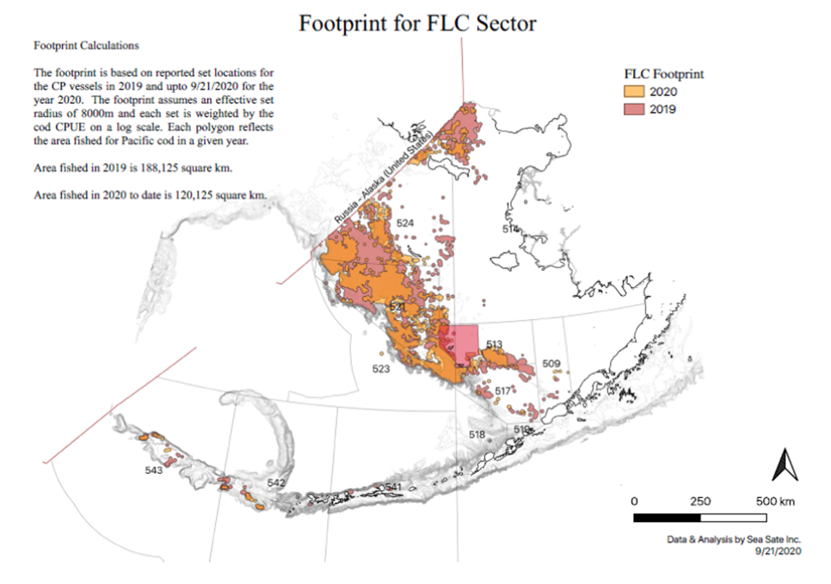
SeaState: CP H&L footprint 2019 and 2020: The CP H&L p-cod fishery is the most spatially dispersed p-cod fishery in the Bering Sea. There is less effort in 2020 above St. Lawrence Island than in 2019. 2020 SST was cooler in 2020 than in 2019.

Slide 26
A major cause of uncertainty in BSAI federal p-cod fisheries is the increasing reallocation to the Statewaters Dutch Harbor Subdistrict GHL p-cod fishery.
EBS p-cod ABC: Declining ABC affects all sectors proportionately – except <60 sector due to large increases in DHS GHL (<58’ pot only).
2006-2013: Total catch inside 3 miles in the BS = 0.67% of BSAI ABC
2013: BOF establishes DHS GHL at 3% of BSAI ABC for <58 CV pot only.
GHL fishery is concentrated in Unimak Pass during spawning aggregation.
GHL fishery has unlimited participation (no limited entry); no observers; and no port sampling provisions. Fishery is a concentrated derby fishery.
2016: GHL increased by BOF to 6.4% of EBS p-cod ABC
2018: GHL increased by BOF to 8% (for 2019) with stairstep to 15%
2019: GHL increased to 9%
2020: GHL increased to 10%

